Slide 1

Job Search:
Social Media Tools and Other Search Engines
TIJJANI AHMAD FCA

Slide 2

Outline
Points for discussion:
  Highlights
  Context
  Why
  Where
  What
  How
  What's next?

Slide 3

Highlights and Key Updates
Unemployment
Nigeria has the most robust economy in Africa. However, th rate of unemployment in Nigeria is confusingly high,
Job Opportunities
There is no job opportunities and the few ones available would scare you from applying
Qualified Candidates
The job opportunities existing in Nigeria outnumber the available qualified persons by over 10:1

Slide 4
Understanding the Context
FGN
MNC
INGOs/NGOs
Private Sector
State
LG
Freelancing
PT/PT
Hybrid
Consultancy
Internship

Slide 5



Understanding Why
Job Opportunities Awareness (?)
Complex Nature of Application
Perceived lack of requirements

Slide 6



Zero Ambition Threshold
Zero Skillsets
Fear of rejection/failure

Slide 7

Understanding the Where?

Slide 8







Slide 9





Slide 10





Slide 11

Understanding the what

Slide 12


Membership of Professional Organization
Volunteering
Internship

Slide 13


Soft and hard skills
Digital footprint

Slide 14
“70% of recruiters will be checking your social media profiles. But the real bummer is that 79% of employers can reject candidates based on their social media” The Manifest 2020 Recruitment Survey
Notes:
5 Personal Branding Tips for Your Job Search | August 2020 (themanifest.com)

Slide 15


Badges
Certifications

Slide 16
“The Semi-illiterate of the future will be people who have degrees but no skills” Anonymous

Slide 17
Joining a Professional Network

Slide 18
????
The What of CVs and Cover Letter
The what of Interviews
Packaging

Slide 19
The What of CVs
Notes:
6 ways to make your CV stand out | TopCV

Slide 20
Acceptable Structure
Professional Profile
Work Experience
Name & Contact
Core Competencies
Educ & Prof Development

Slide 21
Desirable
Wizard (ATS)
2 Page
Tailored CV
Cover letter
Formatting

Slide 22
Packaging

Slide 24
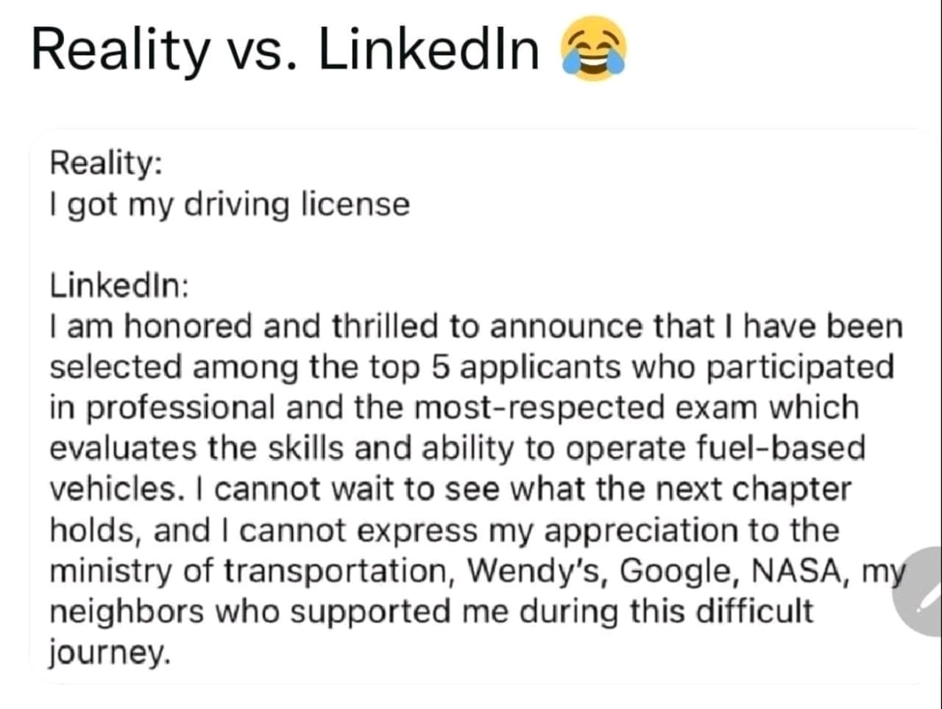

Slide 25

What will I do when I received an invitation letter for an interview?

Slide 26

8 Things To Know Before a Job Interview
What they do
The company mission
The Company culture
The latest news
The company’s history
The company’s competitors
The company’s USP
Management
Notes:
https://www.coburgbanks.co.uk/blog/candidate-tips/8-things-to-research-before-a-job-interview/

Slide 27

What FAQ Do I Need to Know Before the Interview?
Tell Me About Yourself
Why Do You Want This Job?
Why Should We Hire You?
What is Your Greatest Strength?
What is Your Greatest Weakness?
What Are Your Salary Expectations?

Slide 28

What FAQ Do I Need to Know Before the Interview? Contd.
How do you handle stress and pressure
Describe a difficult work situation or project and how you handled It
What are your goals for the future?

Slide 29

What is Behavioral Interview Questions?
Behavioral interview questions are questions that focus on how you've handled different work situations in the past to reveal your personality, abilities and skills.
These questions give an interviewer an idea of how you would behave if a similar situation were to arise, the logic being that your success in the past will show success in the future.

Slide 30

What are some typical examples of behavioral interview questions?
Tell me about an occasion when you had to complete a task under a tight deadline.
Have you ever gone above and beyond the call of duty?
What do you do when a team member refuses to complete his or her quota of the work?
Notes:
https://www.thebalancecareers.com/what-is-the-star-interview-response-technique-2061629

Slide 31
What are some typical examples of behavioral interview questions?
Give me an example of a time you made a decision that was unpopular and explain how you handled implementing it.
Tell me about a goal you failed to achieve.
Tell me about a time when you had to say “no.”

Slide 32

How Do I Make a Great Impression During the Interview?
Practice your answers to common interview questions
Reread the job description
Use the STAR method in answering questions
Recruit a friend to practice answering questions
Prepare a list of references
Be prepared with examples of your work
Prepare smart questions for your interviewers

Slide 33

How Should I Respond To ‘Tell Me About Yourself Question’?

Slide 34
A Simple Formula for Answering “Tell Me About Yourself”
Present: Talk a little bit about what your current role is, the scope of it, and perhaps a big recent accomplishment.
Past: Tell the interviewer how you got there and/or mention previous experience that’s relevant to the job and company you’re applying for.
Future: Segue into what you’re looking to do next and why you’re interested in this gig (and a great fit for it, too).

Slide 35
Example
“I've been in the marketing industry for over five years, primarily working in account and project management roles. I most recently worked as a senior PM for a large tech company managing large marketing campaigns and overseeing other project managers. And now I'm looking to expand my experience across different industries, particularly fintech, which is why I'm so interested in joining an agency like yours”.
Notes:
https://www.themuse.com/advice/tell-me-about-yourself-interview-question-answer-examples

Slide 36
Example 2
Well, I’m currently an account executive at Smith, where I handle our top performing client. Before that, I worked at an agency where I was on three different major national healthcare brands. And while I really enjoyed the work that I did, I’d love the chance to dig in much deeper with one specific healthcare company, which is why I’m so excited about this opportunity with Metro Health Center.
Notes:
https://www.themuse.com/advice/tell-me-about-yourself-interview-question-answer-examples

Slide 37

How Should I Respond to a Behavioral Interview Question?
The STAR interview response method can help you to respond to a behavioural question.
STAR stands for Situation, Task, Action, Result.
Notes:
Using the STAR method, you can provide concrete examples or proof that you possess the experience and skills for the job at hand.

Slide 38

STAR Key Concepts
Situation: Describe the context within which you performed a job or faced a challenge at work. For example, perhaps you were working on a group project, or you had a conflict with a coworker. This situation can be drawn from a work experience, a volunteer position, or any other relevant event. Be as specific as possible.
Task: Next, describe your responsibility in that situation. Perhaps you had to help your group complete a project within a tight deadline, resolve a conflict with a coworker, or hit a sales target.

Slide 39
STAR Key Concepts
Action: You then describe how you completed the task or endeavored to meet the challenge. Focus on what you did, rather than what your team, boss, or coworker did. (Tip: Instead of saying, "We did xyx," say "I did xyz.")
Result: Finally, explain the outcomes or results generated by the action taken. It may be helpful to emphasize what you accomplished, or what you learned.

Slide 40

Example of Interview Question and Answer Using STAR

Slide 41
Example: Tell me about a time you had to complete a task within a tight deadline.
Example Answer: While I typically like to plan out my work in stages and complete it piece by piece, I can also achieve high-quality work results under tight deadlines. Once, at a former company, an employee left days before the imminent deadline of one of his projects. I was asked to assume responsibility for it, with only a few days to learn about and complete the project. I created a task force and delegated work, and we all completed the assignment with a day to spare. In fact, I believe I thrive when working under tight deadlines.

Slide 42

Understanding the how
Having the context, the where and what , the next is how

Slide 43

How Should I Respond To 'Do You Have Any Question For Us'?

Slide 44
Things to Ask …
Can you explain some of the day-to-day responsibilities this job entails?
How would you describe the characteristics of someone who would succeed in this role?
If I were in this position, how would my performance be measured? How often?
What departments does this teamwork with regularly?
How do these departments typically collaborate?
What does that process look like?
What are the challenges you’re currently facing in your role?

Slide 45






Individuals
Mentors
Accountability Partner
Productive Company
Deliberate Practice
Expectation Management
Parents & Prayers

Slide 46




Organizations
Workshops & Info sessions
Linkages
Mentoring Program
Collaboration

Slide 47
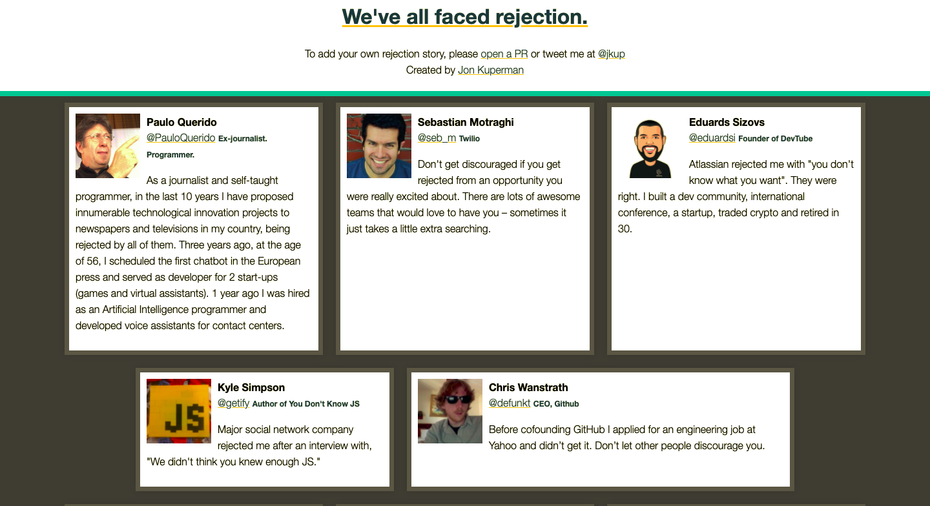
Notes:
https://rejected.us/

Slide 48

Do you have any questions?
ahmatee123@gmail.com

